Slide 1

Computer Graphics
IUP Class

Slide 2
Administrative
Lecturer Name: Anny Yuniarti​
Lecturer Email: anny@if.its.ac.id​
Class Coordinator: … ​
Class Schedule:
Fri 1.30 p.m.​

Slide 3

About the Course

Slide 4

What are the differences of
Computer Graphics,
Digital Image Processing,
Computer Vision?

Slide 5
Expected Learning Outcome
Students are able to describe computer graphics system and graphics pipeline in a graphics library.
Students are able to explain the linear algebra theory applied for computer graphics system.
Students are able to develop and demonstrate a simple graphics program using WebGL.
Students are able to develop and demonstrate an interactive computer graphics application using a graphics library.

Slide 6
Learning Plan
Week | Learning Schedule
1 | Introduction: Painting and drawing, 3D Graphics Elements, H/W and S/W
2 | 2D Graphics (1): Pixels, Coordinates, Colors, Shapes, Transforms
3 | 2D Graphics (2): Hierarchical Modeling, HTML Canvas Graphics
4 | Introduction to WebGL (1): Programmable Pipeline, GLSL
5 | Introduction to WebGL (2): Image Textures, 2D Transforms
6 | 3D Graphics with WebGL (1): 3D Transformation, Lighting, Material
7 | 3D Graphics with WebGL (2): Textures, Framebuffers, WebGL Extensions
8 | Mid-semester exam

Slide 7
Rencana Pembelajaran Semester (RPS)
Week | Learning Schedule
9 | Three.js – A 3D Scene Graph API: Basics, Building Objects, Other Features
10 | Student Presentation (lighting, materials)
11 | Student Presentation (advanced geometry, mesh)
12 | Student Presentation (textures, animation)
13 | Final Project Proposal Discussion
14 | Final Project Proposal Presentation
15 | Beyond Basic 3D Graphics: Ray Tracing, Path Tracing
16 | Final Project Demo

Slide 8
Marking Scheme
Individual assignments: 25%
Mid-semester exam: 25%
Presentation assignments (group): 20%
Final Project (group): 30%

Slide 9
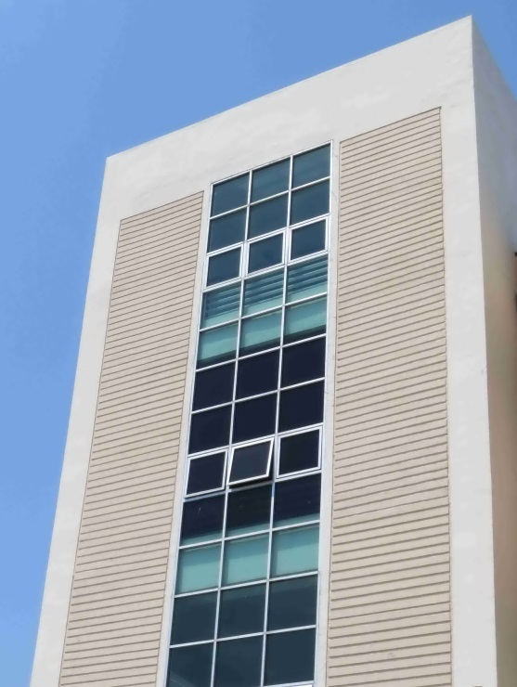
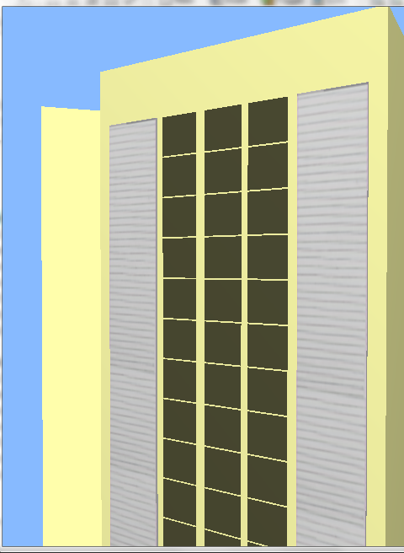
Some Works by Previous Students

Slide 10
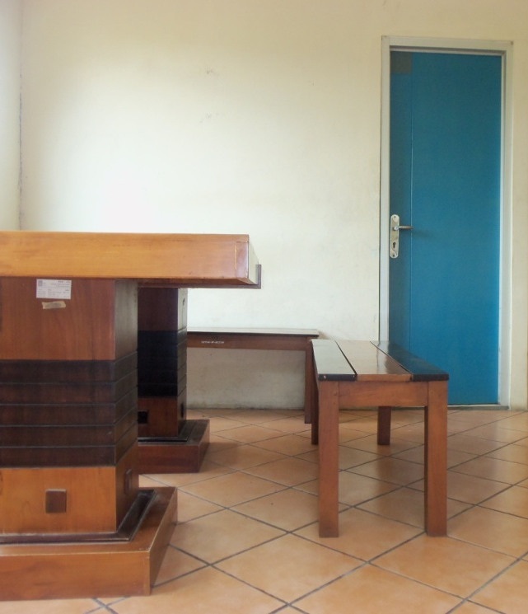
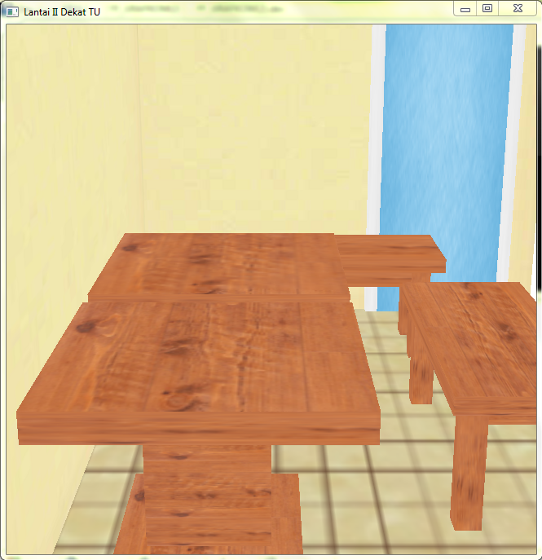
Some Works by Previous Students

Slide 11
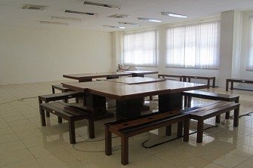
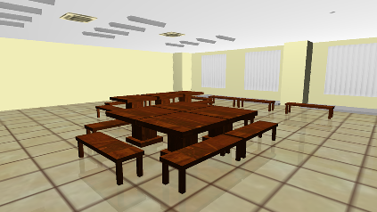
Some Works by Previous Students

Slide 12
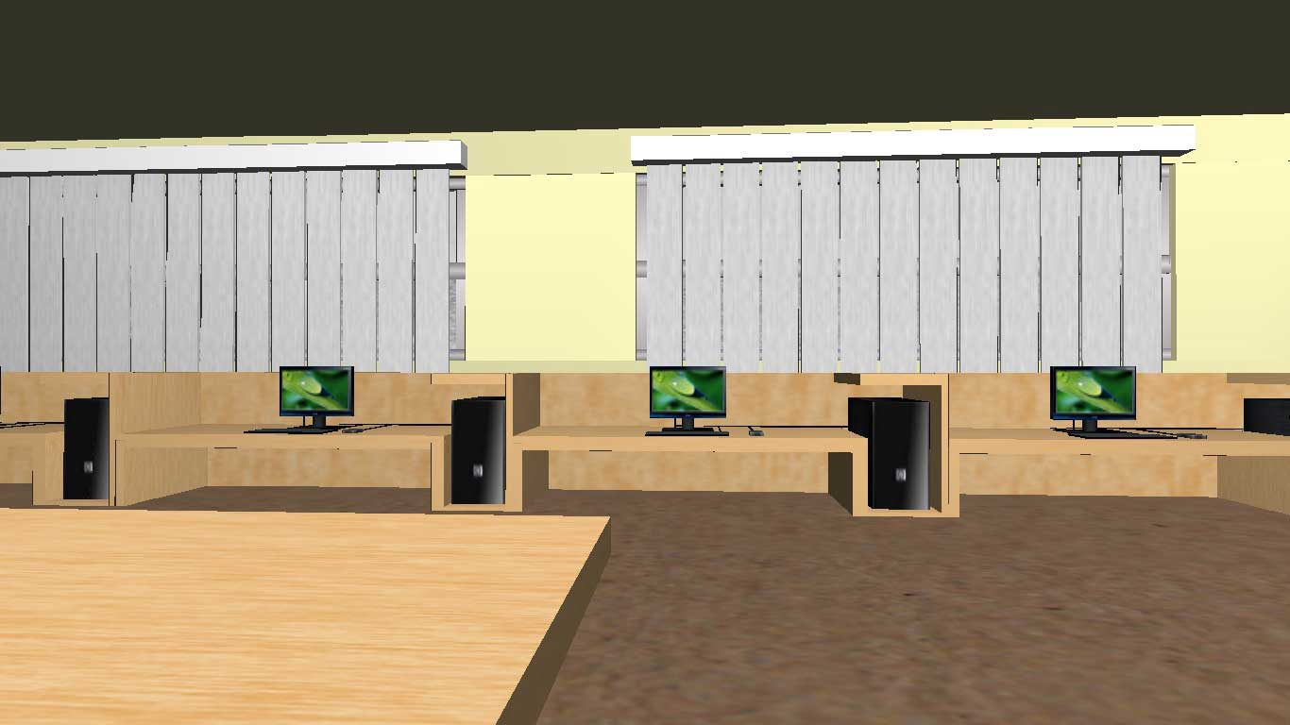
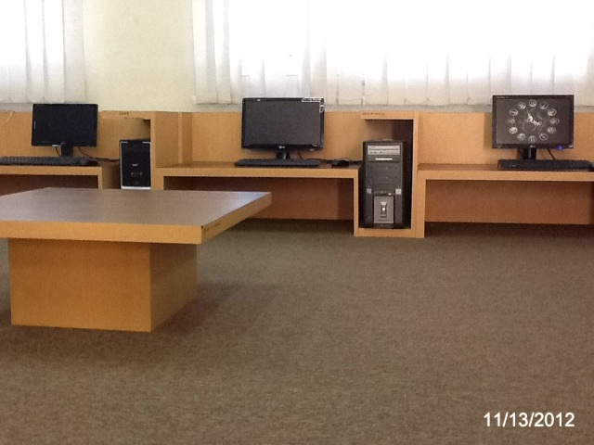
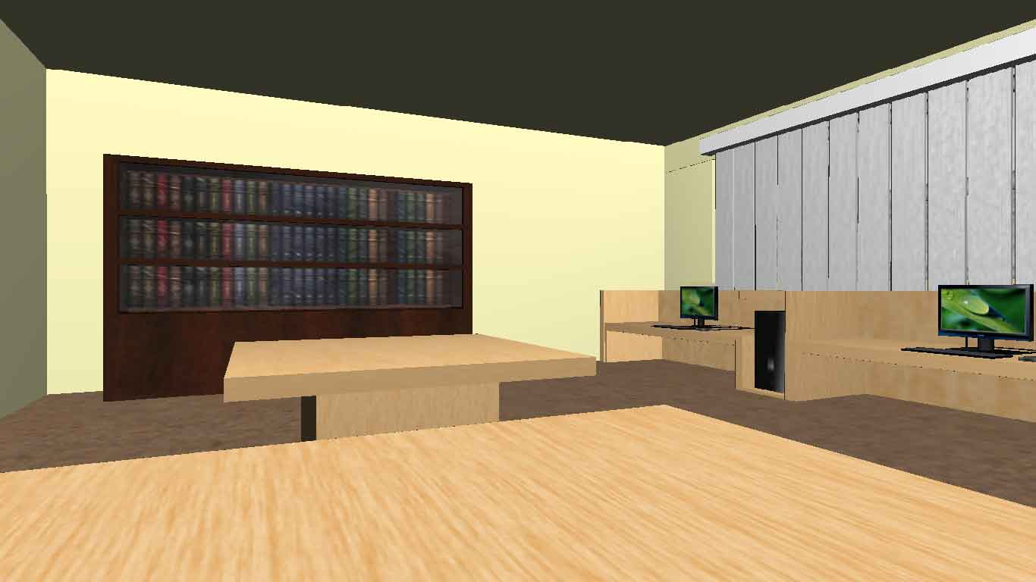
Some Works by Previous Students

Slide 13
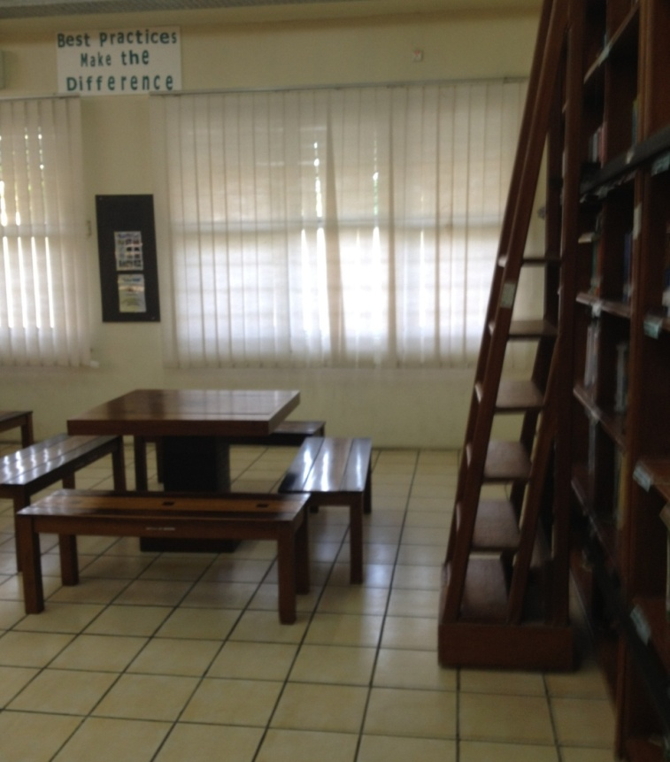
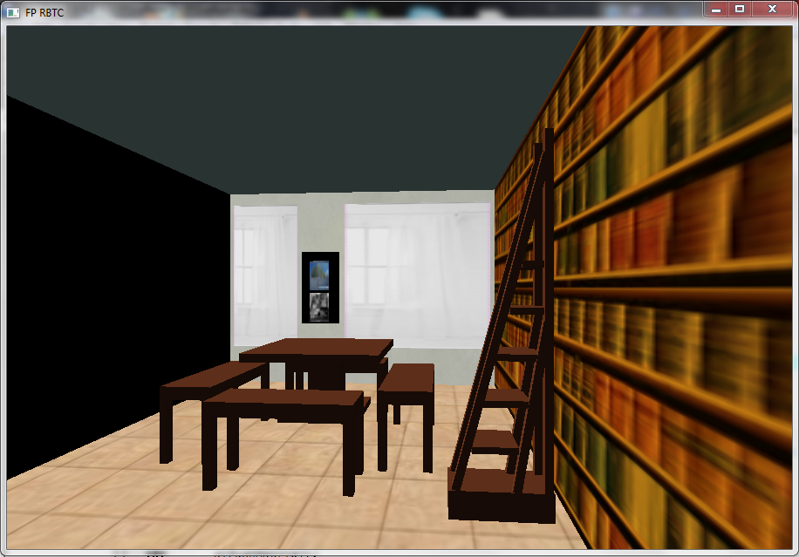
Some Works by Previous Students

Slide 14
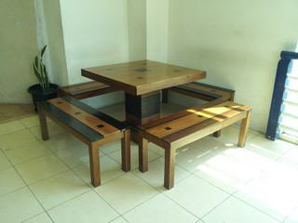
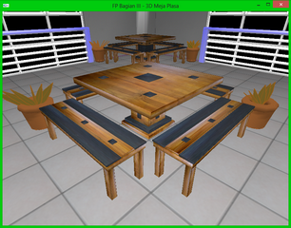
Some Works by Previous Students

Slide 15
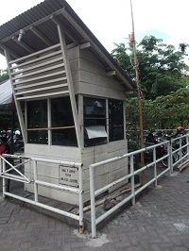
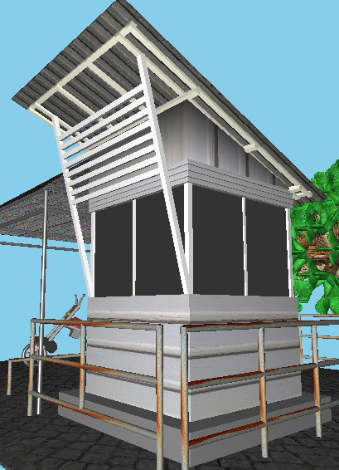
Some Works by Previous Students

